Slide 1


Data Modelling in powerBI
Dr. Jitha P Nair

Slide 2
Understanding and Managing Relationships in Power BI Desktop
Relationships between tables are essential for accurate analysis and reporting in Power BI Desktop.
Power BI Desktop offers automatic relationship detection and manual creation/editing options.

Slide 3
Auto detecting Relationships
Power BI Desktop automatically attempts to detect relationships when querying multiple tables.
It analyzes column names to identify potential relationships.
Autodetect sets Cardinality, Cross filter direction, and Make this relationship active.
Relationships are created automatically with high confidence matches.
Follow the steps:
On the Modeling tab, select Manage relationships > Autodetect.
Power BI Desktop identifies and creates relationships based on column names.
Automatic configuration of Cardinality, Cross filter direction, and Make this relationship active.

Slide 4
Manual Creation of Relationships
On the Modeling tab, select Manage relationships > New.
In the Create relationship dialog box:
Select the first table and the column for the relationship.
Select the second table and the corresponding column.
Click OK.
Default settings for Cardinality, Cross filter direction, and Make this relationship active are applied.
Modify these settings as needed.

Slide 5
Managing Existing Relationships
On the Modeling tab, select Manage relationships.
The Manage relationships dialog box displays all existing relationships.
Edit relationships by selecting them and clicking Edit.
Modify settings such as Cardinality, Cross filter direction, and Make this relationship active.
Delete relationships if necessary.

Slide 6
Benefits of Proper Relationship Management
Accurate calculation of results using data from multiple tables.
Correct display of information in reports and visualizations.
Improved data integrity and consistency.
Enables cross-filtering and slicer interactions across related tables.

Slide 7
Cardinality in Power BI Relationships
Cardinality defines the type of relationship between tables in Power BI.
Cardinality options determine how values in one column relate to values in another column.
Many to One Relationship (*:1)
Many-to-one relationship is the most common type.
In this relationship, a column in one table can have multiple instances of a value.
The related table (lookup table) has only one instance of that value.

Slide 8
Cardinality in Power BI Relationships
One to One Relationship (1:1)
One-to-one relationship means that each value in a column of one table has a unique match in the related table.
Both tables have only one instance of a particular value.
One to Many Relationship (1:*)
One-to-many relationship occurs when each value in a column of one table has a unique match in the related table.
The related table can have multiple instances of the value from the primary table.

Slide 9
Cardinality in Power BI Relationships
Many to Many Relationship (:)
Many-to-many relationship is possible in Power BI through composite models.
It allows establishing relationships where both tables can have multiple instances of values.
This removes the need for unique values in the tables and previous workarounds.

Slide 10
Cross Filter Direction
Cross filter direction determines how filtering choices in connected tables affect the data in Power BI.
Two options: Both and Single.

Slide 11
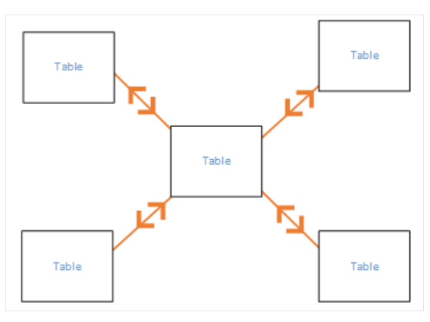
Both Cross Filter Direction
Both setting treats both tables as a single table for filtering purposes.
Useful in star schema configurations, where a central table has multiple lookup tables.
All tables are filtered together as if they were one entity.
Example: Sales actuals table with a department lookup table.

Slide 12
Single Cross Filter Direction
Filtering choices in connected tables work on the table where values are being aggregated.
Data is filtered based on the table where the analysis is being performed.
Typically used when importing a Power Pivot in Excel 2013 or earlier data model.

Slide 13
Example
cross-filtering in Power BI using two tables: "Sales" and "Products."
Sales Table:
Columns: Order ID, Product ID, Quantity, Sales Amount
Contains sales data with information about each order, the associated product, quantity sold, and sales amount.
Products Table:
Columns: Product ID, Product Name, Category, Price
Contains information about each product, including the product name, category, and price.

Slide 14
Example
Single Cross-Filtering (Default):
Suppose we create a relationship between the "Sales" table (Order ID) and the "Products" table (Product ID) with the default single cross-filtering direction.
In Power BI visuals, if we filter or slice the "Sales" table by a specific product category (e.g., "Electronics"), only the sales data related to that category will be displayed.
The "Products" table remains unaffected, showing all products irrespective of the applied filter.

Slide 15
Example
Both Cross-Filtering:
Now, let's change the cross-filtering direction to "Both" for the relationship between the "Sales" and "Products" tables.
If we apply a filter on the "Sales" table to show sales data for a specific product category (e.g., "Electronics"), not only will the "Sales" table be filtered, but the "Products" table will also be filtered.
As a result, only the products belonging to the filtered category will be displayed in the "Products" table, providing a more contextual view of the data.

Slide 16
THANK YOU

